Slide 1


TIGER: Tor Traffic Generator for Realistic Experiments
Daniela Lopes¹, Daniel Castro¹, Diogo Barradas², Nuno Santos¹
¹ INESC-ID / IST, Universidade de Lisboa
² University of Waterloo
¹ {daniela.lopes,daniel.castro,nuno.m.santos}@tecnico.ulisboa.pt
² diogo.barradas@uwaterloo.ca
November, 26th, WPES ‘23
Notes:
Hello everyone! Today we are presenting TIGER: a Tor Traffic Generator for Realistic Experiments.
I am Daniela Lopes, and this work was done in cooperation with Daniel Castro, Diogo Barradas, and Nuno Santos, from Universidade de Lisboa and University of Waterloo.

Slide 2



On the need for a comprehensive Tor testbed
Several users rely on Tor to protect their privacy online.
Journalists.
Human rights activists.
Censored users.
Several attacks have been proposed.
Evaluating those attacks in the real-world is challenging.
Notes:
[CLICK] Tor is currently the most widely adopted anonymity network, helping safeguard the privacy of Internet users, including journalists, human rights activists, and censored users.
[CLICK] However, several attacks have been proposed recently that compromise the privacy of Tor users. Unfortunately, evaluating the impact of such attacks in the real-world is a significant challenge, due to the difficulties in getting reliable datasets that do not compromise Tor users’ privacy.
[CLICK] [CLICK] [CLICK] Several works in multiple venues have also demonstrated that evaluating attacks on the Tor network with unrealistic datasets leads to overestimating their performance.

Slide 3
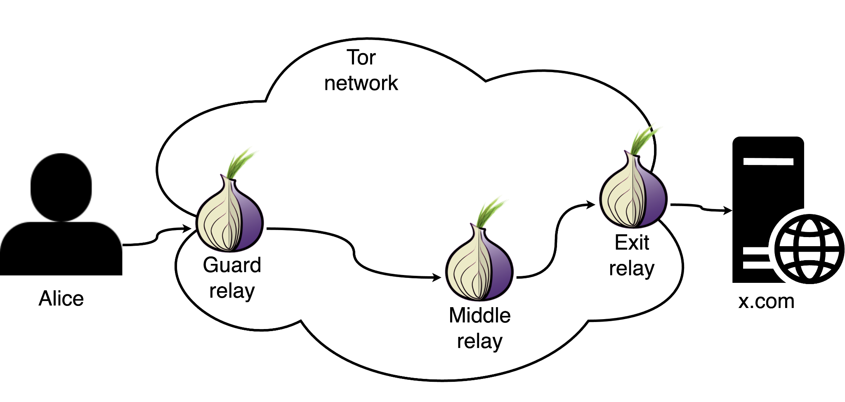
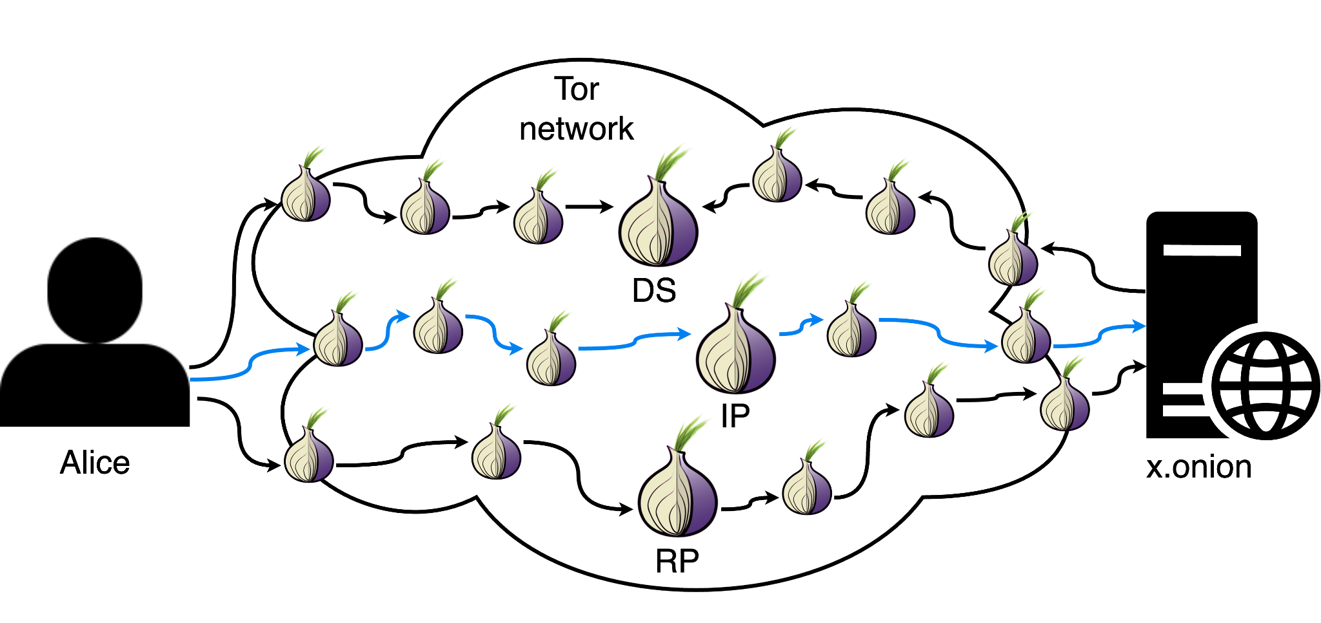
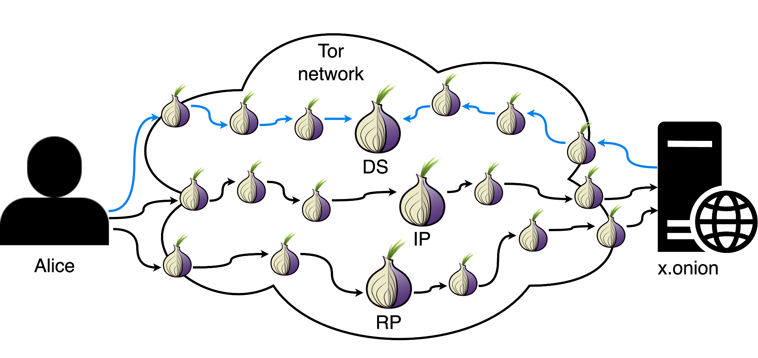
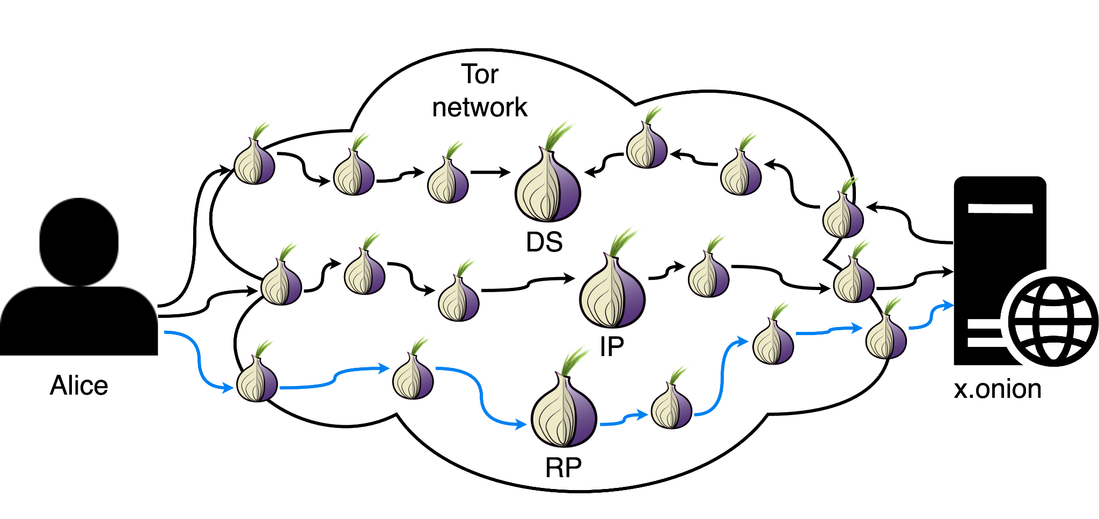
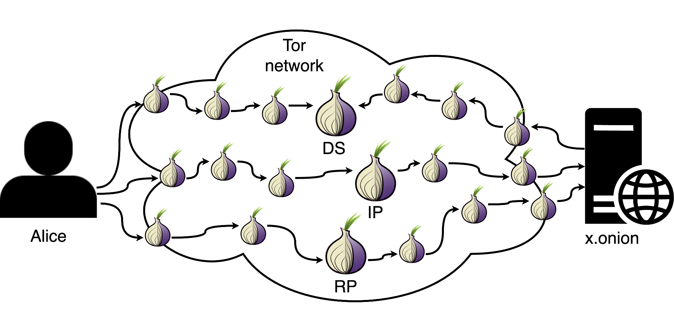
Tor
Circuits to the Internet:
Circuits to onion services:
Notes:
[CLICK] Tor enforces its anonymity by tunnelling communications through circuits composed of 3 relays (guard, middle and exit relays) and encapsulating the messages in multi-layer encryption. Each relay “peels” a layer of encryption and passes it to the next relay. This way, no relay knows both the sender and the receiver, providing anonymity to the users.
[CLICK] However, this scheme does not provide services with anonymity. To this end, Tor introduced onion services. These act as other services that we know, such as Internet websites, but their IP addresses remain private, even from the users accessing them.
For this, when Alice wants to access x.onion [CLICK], it gets an Introduction Point (IP) published by x.onion from the Tor Directory Servers (DS) and chooses a Rendezvous Point (RP).
[CLICK] Alice communicates the Rendezvous Point to the Introduction Point,
[CLICK] and a session is established between Alice and x.onion.

Slide 4
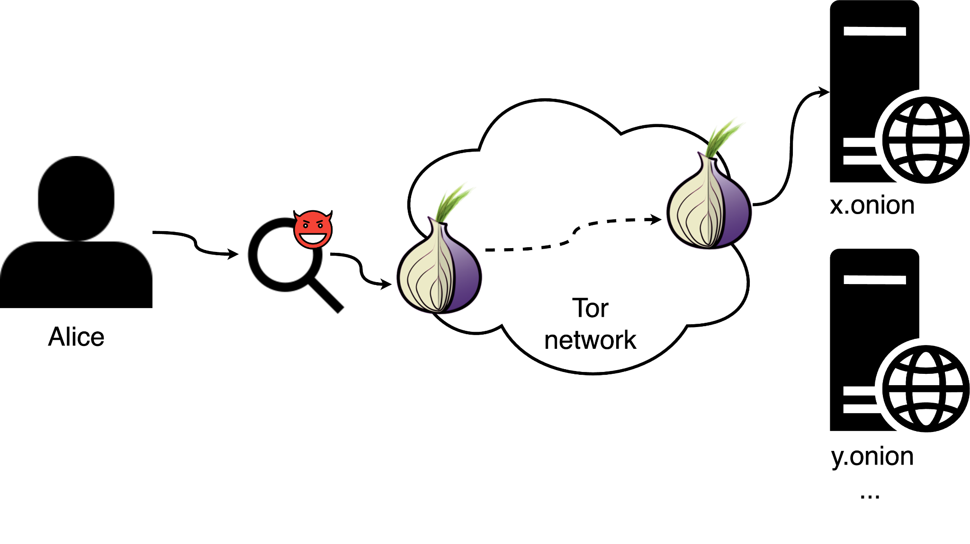
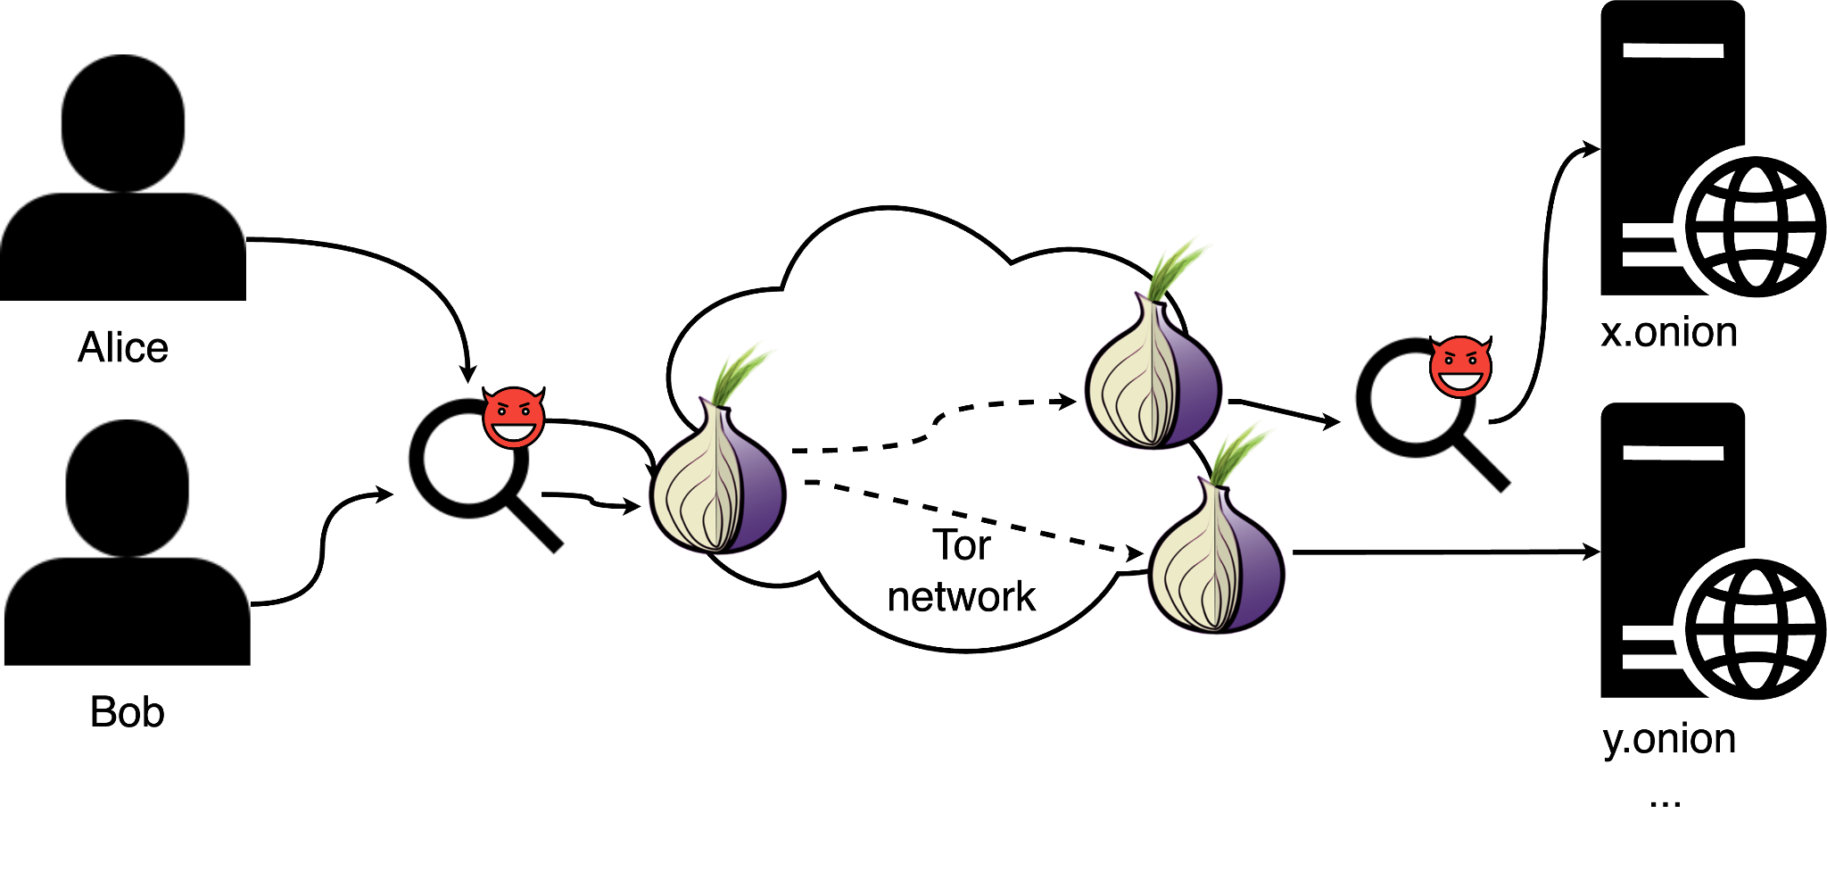
Attacks on Tor
Website fingerprinting:
Traffic correlation:
Testing these attacks in realistic conditions is paramount!
Notes:
Several attacks based on traffic analysis have been proposed that threaten to compromise Tor users.
Two widely studied attacks are website fingerprinting and correlation attacks.
[CLICK] Website fingerprinting attacks: Here, the attacker observes the traffic between the client Alice and its guard node, and tries to infer that Alice is accessing x.onion out of a set of known websites.
[CLICK] Traffic correlation attacks: In this, an adversary can observe both ends of the communication.
In the example, Alice is accessing x.onion and Bob is accessing y.onion.
The adversary intercepts both Alice and Bob’s communication at the client side, but only intercepts Alice’s communication on the onion service-side.
With this, the adversary will try to match that Alice was accessing x.onion and find out their IP addresses.
These attacks can compromise Tor’s privacy guarantees.
[CLICK] Testing these attacks in realistic conditions is paramount to understanding how dangerous and feasible they are against the Tor network, and what countermeasures can be applied to mitigate them and make the Tor network more resilient.
The most obvious approach would be to use the actual Tor network and monitor real users’ traffic. But this raises several ethical questions.
Now, we will show existing alternatives and propose our own alternative to generating realistic traffic.

Slide 5

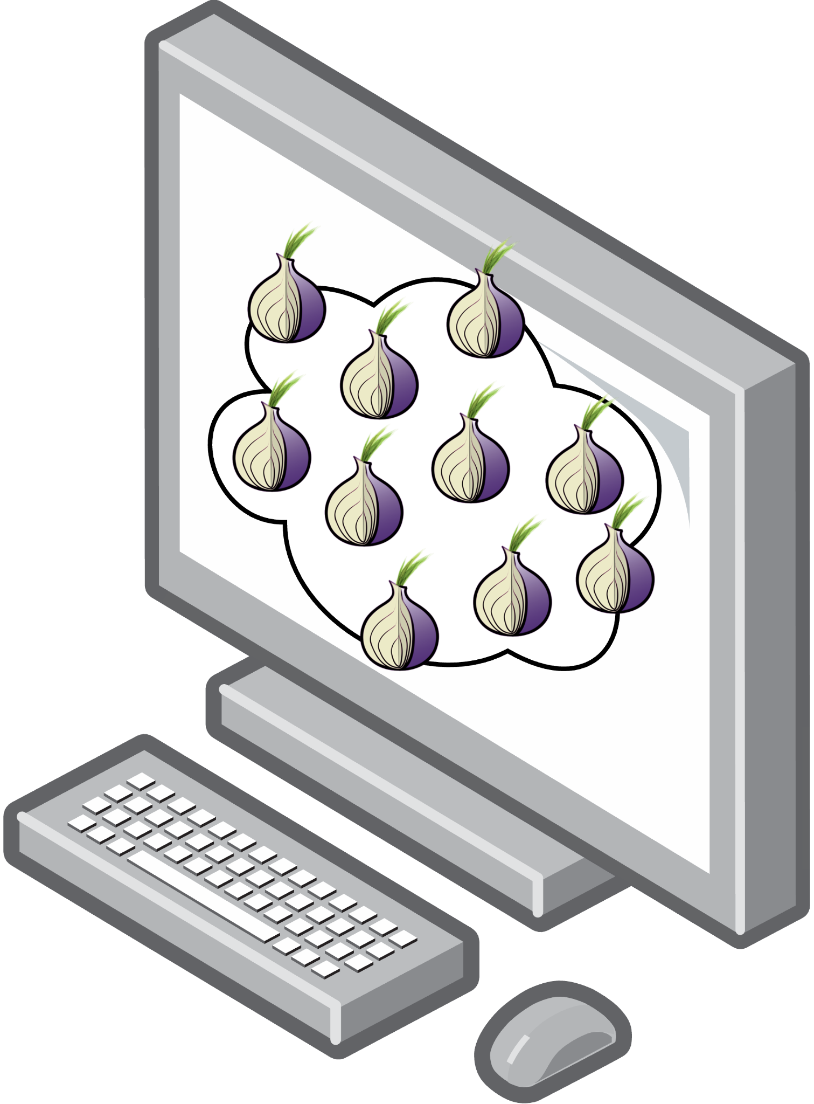
Existing approaches: Simulation
Replicate Tor in a single machine^{1,2,3}.
Model has to be accurate.
Unrealistic relay sampling.
No geographical distribution.
Low customizability.
¹Shadow: Running Tor in a Box for Accurate and Efficient Experimentation, NDSS, 2011
²Towards Predicting Efficient and Anonymous Tor Circuits, USENIX Security, 2018
³Data-Explainable Website Fingerprinting with Network Simulation, PoPETS, 2023
Notes:
Now, we will discuss existing approaches for collecting Tor traffic datasets!
One of the most widely used approaches to test attacks on Tor is simulation.
[CLICK] Simulation allows replicating the Tor network on a single machine while trying to replicate some network characteristics, such as bandwidth, latency, or throughput.
This approach is very desirable due to requiring few resources and being very practical.
However, this approach
[CLICK] depend heavily on the model of the network being very accurate and staying that way over time.
[CLICK] They generally sample relays that do not represent the whole Tor network, such as their bandwidth weights, which are used to choose the relays used to establish circuits, or the types of relays each node can be.
[CLICK] They ignore the geographical location of these relays,
[CLICK] and lack customizability, such as not allowing to customize the software running on each relay.
For these reasons, it might not accurately simulate important characteristics of the Tor network.

Slide 6
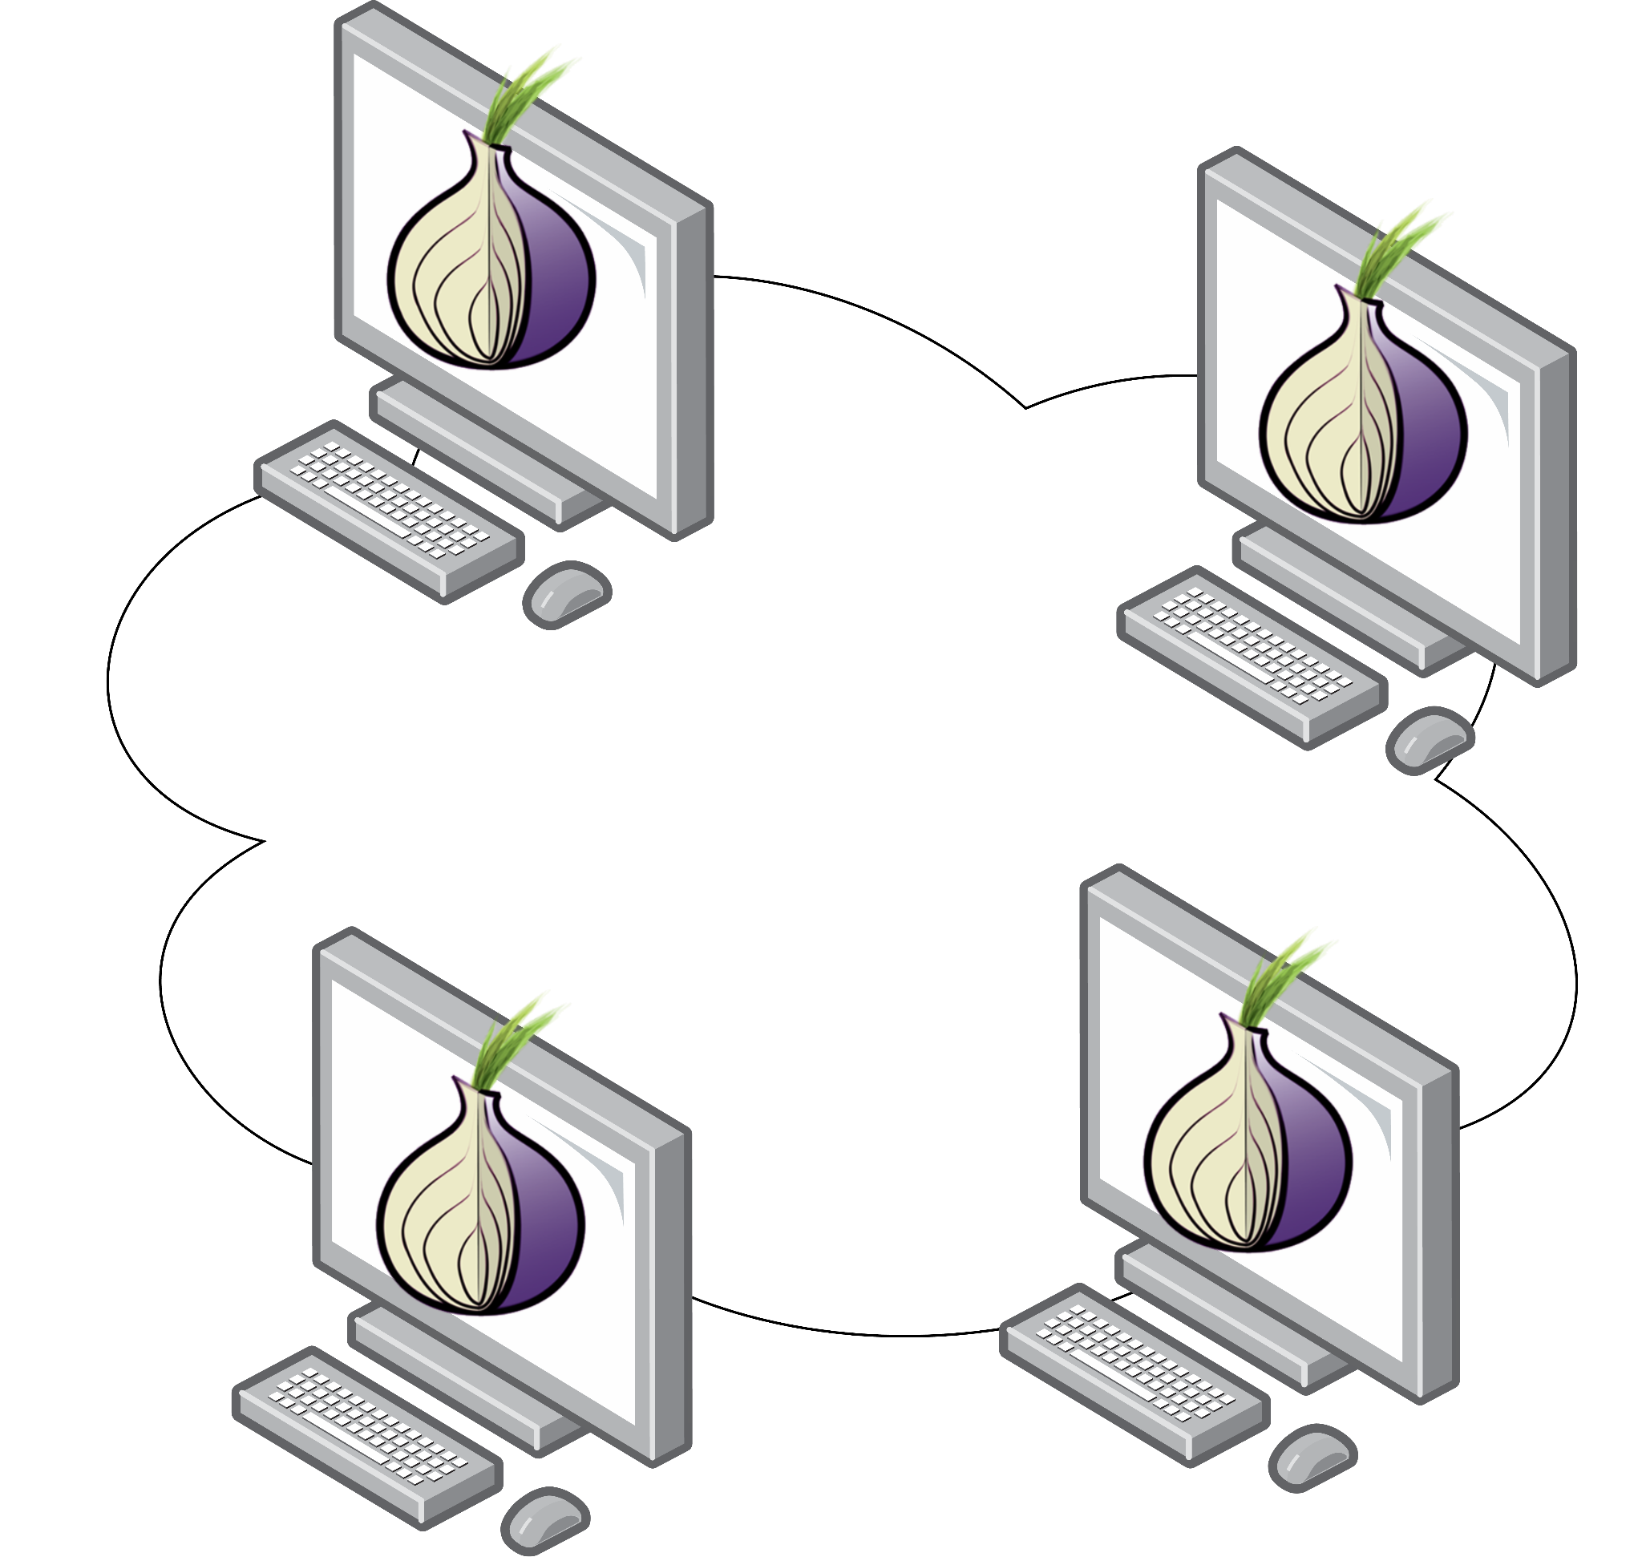
Existing approaches: Emulation
Set of machines that replicate Tor^{1,2}.
Same as Simulation.
But less scalable.
Simulation and emulation may be limited in reproducing an authentic environment
¹ExperimenTor: A Testbed for Safe and Realistic Tor Experimentation, CSET, 2011
²LASTor: A Low-Latency AS-Aware Tor Client, IEEE Security and Privacy, 2012
Notes:
Another alternative is emulation, which is quite similar to simulation
[CLICK] but it runs the actual Tor software through a set of machines that implement their own private network.
They also allow tuning network conditions, such as bandwidth and latency, and may offer higher fidelity since they capture actual interactions with real hardware.
[CLICK] However, emulation shares some of Simulation limitations, such being hard to model the Tor network, [CLICK] but suffers from even smaller scalability since it requires more resources. A smaller scale will necessarily impact the representation that we have of the Tor network.
[CLICK] In sum, simulation and emulation approaches are more practical and resource-efficient ways to make experiments in Tor, but they may be limited in cases where we need an authentic environment.

Slide 7
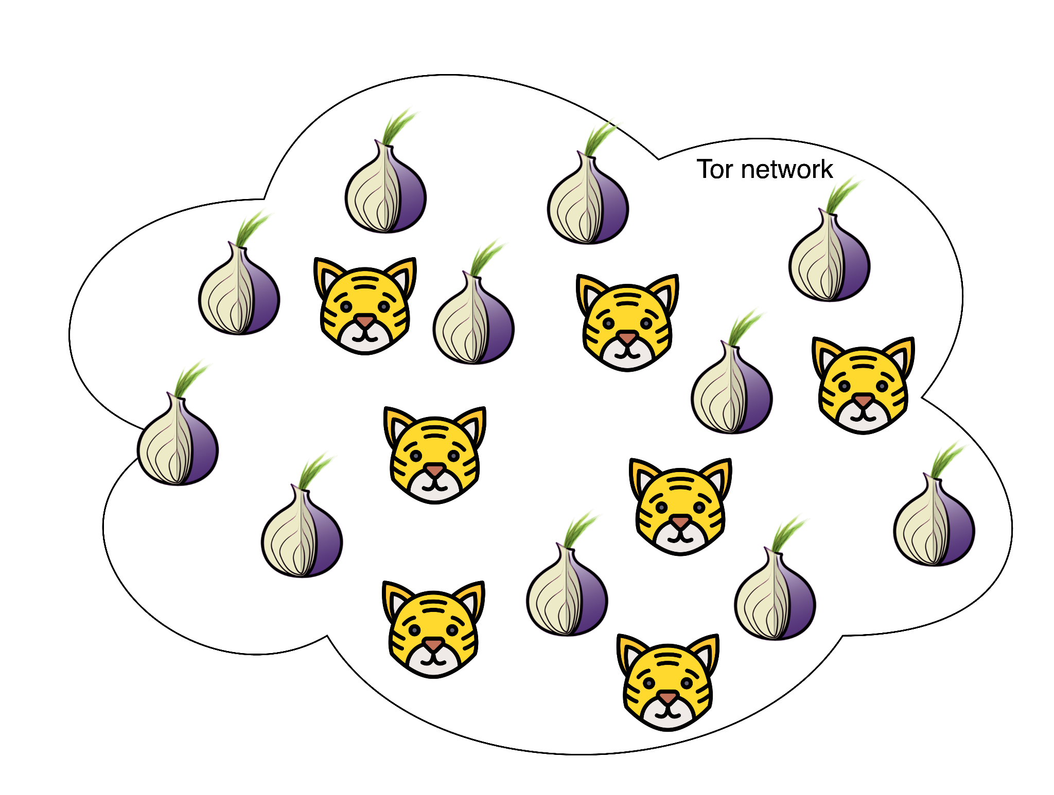
Existing approaches: Live experiments
Run additional nodes on Tor^{1,2,3,4}.
Resource-intensive and manual.
Disturb the Tor network.
No unified methodology.
Create a unified framework for Tor live experiments.
¹Online Website Fingerprinting: Evaluating Website Fingerprinting Attacks on Tor in the Real World, USENIX Security, 2022
²WTF-PAD: Toward an Efficient Website Fingerprinting Defense for Tor, arXiv, 2015
³DeepCorr: Strong Flow Correlation Attacks on Tor Using Deep Learning, ACM CCS, 2018
⁴Inflow: Inverse Network Flow Watermarking for Detecting Hidden Servers, IEEE INFOCOM, 2018
Notes:
[CLICK] Live experiments consist of deploying our own nodes on the actual Tor network. This approach is widely used for studies that depend on very accurate characteristics of Tor and high customizability, such as onion service characterization.
[CLICK] However, these experiments require a lot of manual work and resources
[CLICK] They can disturb the Tor network
[CLICK] and lack standardized procedures. For instance, if I want to compare the accuracy of my website fingerprinting classifier with an older one, I either have to use the same dataset as they used if publicly available, or test the older classifier with my own dataset, which can result in a very unfair comparison.
[CLICK] In summary, is is paramount for the research community to have a unified framework for live experiments in the Tor network.

Slide 8

TIGER: Tor Traffic Generator for Realistic Experiments
A system to automate the creation of Tor traffic datasets.
Approximate traces to real users’ traffic.
Boost the opportunities for research on Tor.
Complement simulation and emulation approaches.
Offer an alternative with higher customizability.
Notes:
We present TIGER, a Tor Traffic Generator for Realistic Experiments. It aims to automate and standardize the creation of datasets composed of Tor traffic, respecting a parameterizable set of conditions, towards approximating the traces that could be obtained from real users’ traffic.
Our framework aims to boost the opportunities for research with respect to attacks and defenses on Tor.
TIGER does not replace simulation or emulation approaches, but it complements them by enabling easier collection of Tor traffic which can be used to produce accurate models of the Tor network, and offers a practical alternative for more demanding scenarios.

Slide 9
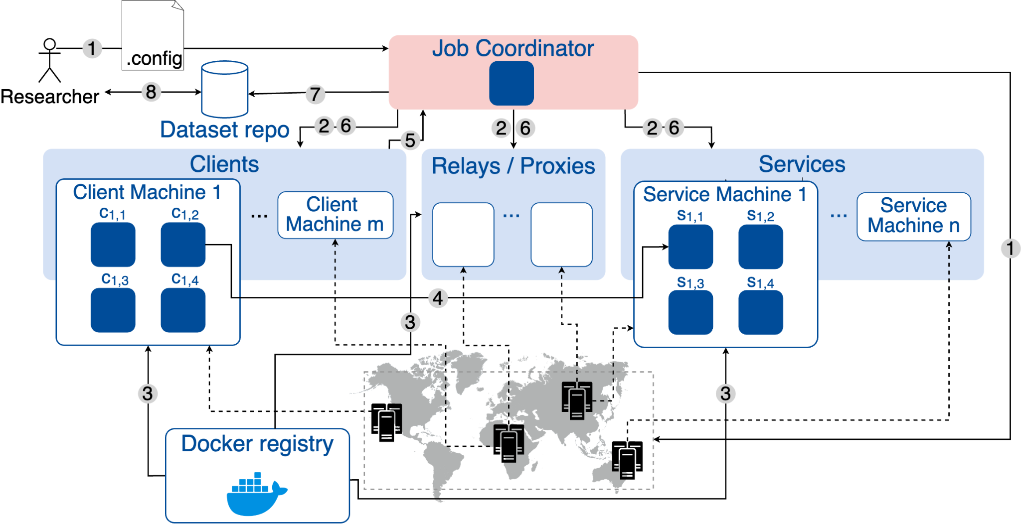
TIGER: Architecture
Step 1: Configure and launch experiment.
Step 2: Launch physical machines.
Step 8: Researcher downloads dataset.
Step 3: Download and run container images.
Step 4: Clients browse the services.
Step 5: Clients finished the experiment.
Step 6: Job coordinator fetches dataset parcels.
Step 7: Job coordinator publishes dataset.
1
8
7
2
6
5
2
6
2
6
1
4
3
3
3
Notes:
To tackle these challenges, we proposed the framework in the figure. TIGER leverages multiple physical machines, which can belong to cloud providers or research institution clusters, and docker containers as the baseline for a fast, flexible, and portable deployment of a network of nodes running on top of the live Tor network.
[CLICK] To launch an experiment, the researcher details the characteristics of the experiment, such as duration and which nodes to create in a configuration file.
[CLICK] Step 2 pictures an extra machine, the job coordinator, that orchestrates the experiment and bootstraps the physical machines.
[CLICK] Then, the job coordinator proceeds to download and run the selected container images, in step 3. Each client or service machine can handle multiple containers, increasing the experiment’s scalability.The container images are made publicly available in a Docker registry to expand TIGER’s functionality according to the requirements of a given experiment.
[CLICK] Each client container runs a Tor client process and executes a desired crawling script to access the services and coordinate the traffic captures in step 4.
[CLICK] An experiment ends when all clients have reached the number of requests proposed in the configuration file, by having each client send a terminate request to the job coordinator, as shown in step 5.
[CLICK] Then, in step 6, the job coordinator fetches the dataset parcels from all the experiment machines and stops all the machines.
[CLICK] In step 7, the job coordinator publishes the complete dataset on a repository.
[CLICK] Finally, in step 8, the researcher downloads the dataset from the repository.
The final dataset is composed of a list of network captures, each encompassing the times, sizes, directions of packets, and the IP addresses and ports involved.
Tor overloading prevention: To prevent overloading the Tor network, we will make use of CollectTor, a tool provided by the Tor project that publishes relay information every hour. TIGER’s job coordinator can periodically retrieve this data to limit the bandwidth exerted by each client on the Tor network, ensuring the experiment being run does not straggle Tor’s network capacity.

Slide 10

Conclusion
It’s hard to research Tor.
TIGER, a framework to generate realistic traffic datasets in the live Tor network.
Future directions:
Extend clients’ functionality.
Validate Tor simulators and emulators.
Compare with Shadow datasets.
Contact us
daniela.lopes@tecnico.ulisboa.pt
Notes:
To conclude: Researching Tor and testing attacks and mitigations in realistic conditions is hard.
This paper introduced TIGER, a versatile framework that generates realistic Tor traffic datasets through the live network.
We generated a TIGER dataset and showed that it is able to represent several real-world Tor characteristics, making it a powerful tool to study the Tor network.
Future directions: To improve TIGER include:
Build client images that can access private pages, such as bypassing CAPTCHAs and login screens, or gather ground truth from multi-tab clients.
Devise a tool that can validate Tor network simulators and emulators using TIGER datasets.
Validate the datasets through testing with established attacks.
And compare TIGER datasets with Shadow datasets.
We have developed an initial prototype for TIGER, which has been very useful for our team, and we intend to keep improving it. If you have interest, please contact us on my email: daniela (dot) lopes (at) tecnico (dot) ulisboa (dot) pt.
Now, we would like to answer some questions from the audience.

